Slide 1
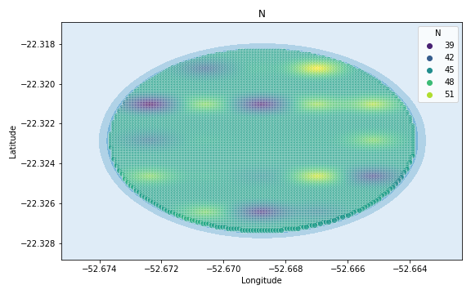
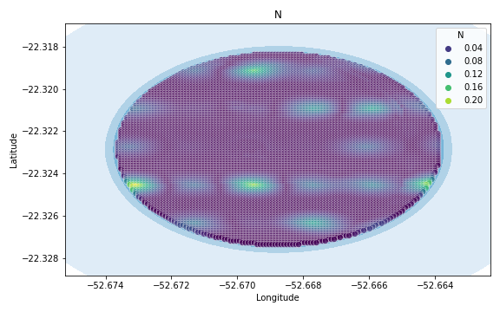
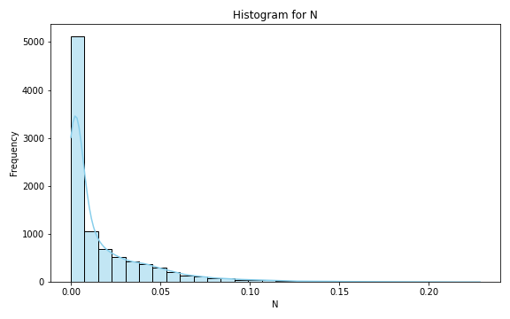
Analysis for column: N Model: Linear Regression
Statistics:
mean 1.803533e-02
std 2.638661e-02
min 6.574101e-07
25% 1.664223e-03
50% 5.807204e-03
75% 2.485687e-02
80% 3.223023e-02
85% 4.111452e-02
90% 5.193862e-02
95% 7.153132e-02
99% 1.203399e-01

Slide 2
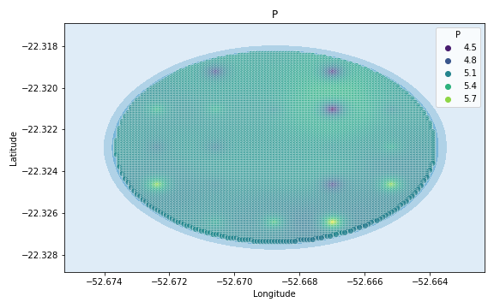
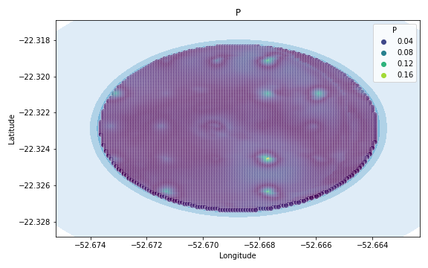
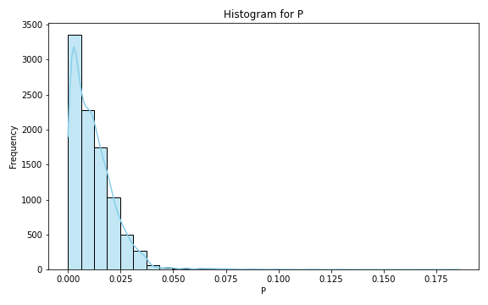
Analysis for column: P Model: Linear Regression
Statistics:
mean 1.200596e-02
std 1.106018e-02
min 4.504595e-07
25% 3.977822e-03
50% 9.819275e-03
75% 1.708780e-02
80% 1.905912e-02
85% 2.140851e-02
90% 2.487779e-02
95% 3.031270e-02
99% 4.794881e-02

Slide 3
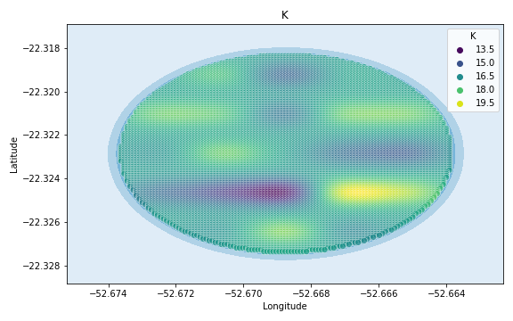
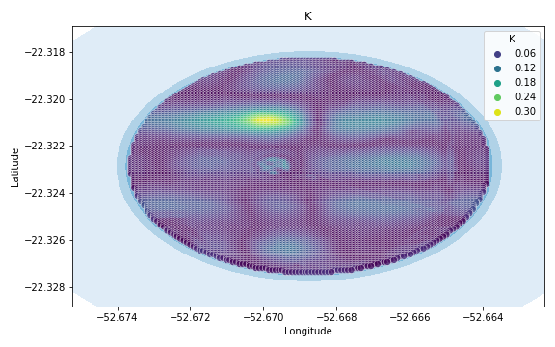
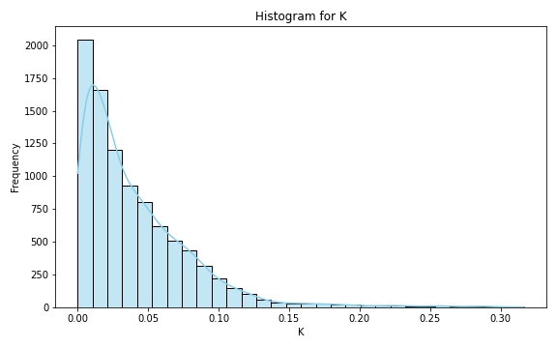
Analysis for column: K Model: Linear Regression
Statistics:
mean 0.041733
std 0.042029
min 0.000012
25% 0.012265
50% 0.029197
75% 0.058820
80% 0.067752
85% 0.077863
90% 0.090423
95% 0.115010
99% 0.217505

Slide 4
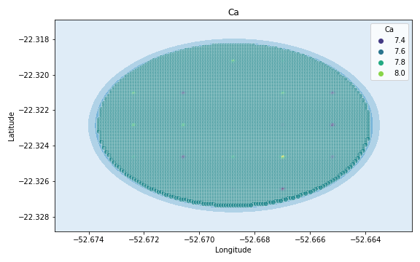
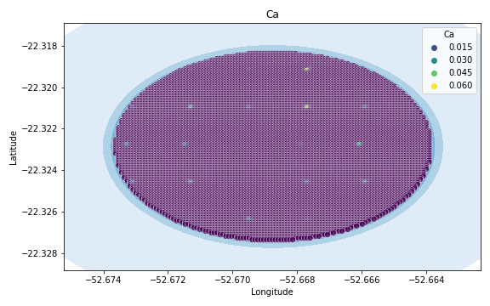
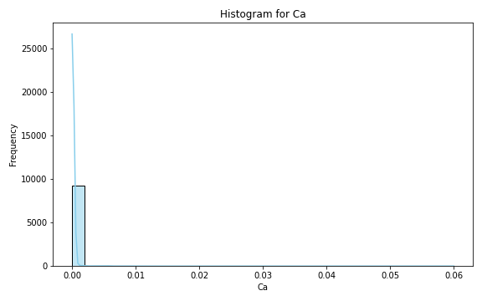
Analysis for column: Ca Model: Linear Regression
Statistics:
mean 1.738905e-04
std 1.631417e-03
min 2.525842e-09
25% 2.317127e-05
50% 4.984345e-05
75% 8.892514e-05
80% 1.010031e-04
85% 1.176117e-04
90% 1.458510e-04
95% 2.152669e-04
99% 1.519512e-03

Slide 5
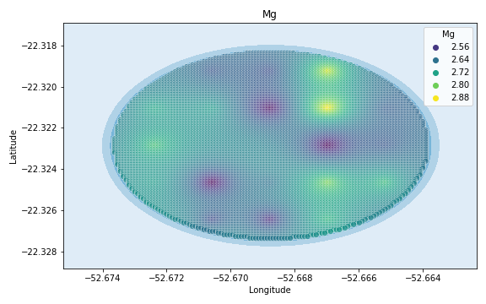
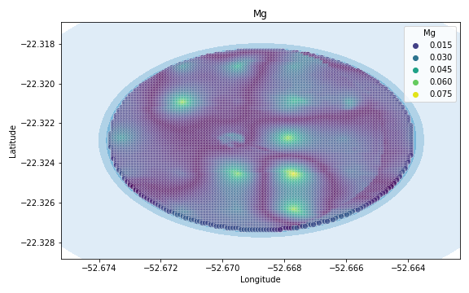
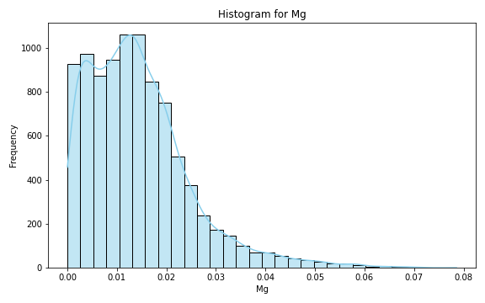
Analysis for column: Mg Model: Linear Regression
Statistics:
mean 0.014346
std 0.010490
min 0.000002
25% 0.006565
50% 0.012845
75% 0.019370
80% 0.021129
85% 0.023586
90% 0.027095
95% 0.034203
99% 0.050367

Slide 6
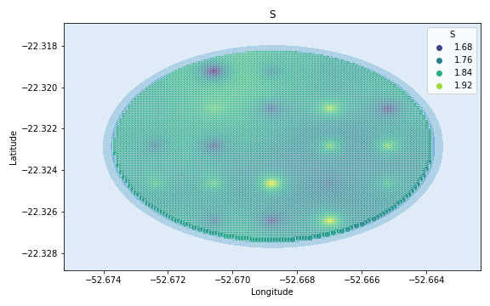
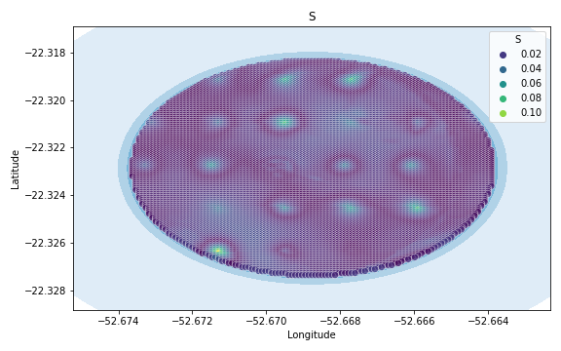
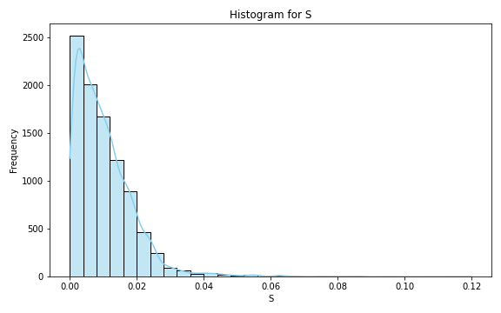
Analysis for column: S Model: Linear Regression
Statistics:
mean 1.022024e-02
std 8.928057e-03
min 4.821832e-07
25% 3.691744e-03
50% 8.296923e-03
75% 1.429282e-02
80% 1.614936e-02
85% 1.808422e-02
90% 2.058608e-02
95% 2.481733e-02
99% 4.298229e-02

Slide 7
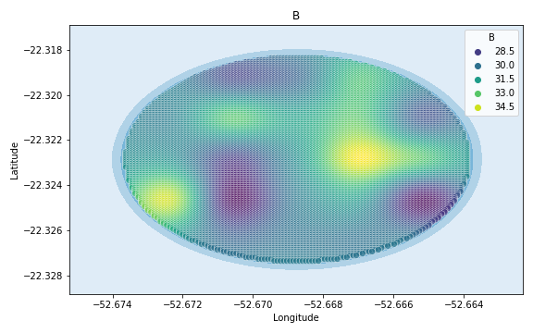
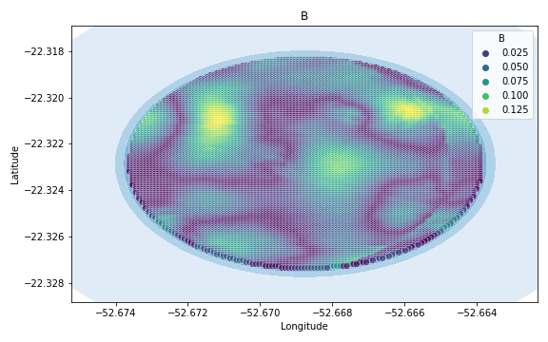
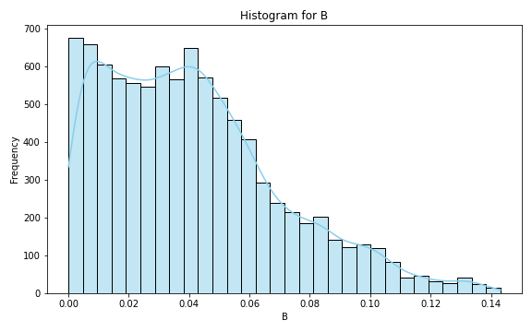
Analysis for column: B Model: Linear Regression
Statistics:
mean 0.041179
std 0.029309
min 0.000002
25% 0.017761
50% 0.037223
75% 0.057531
80% 0.063526
85% 0.072119
90% 0.083624
95% 0.098738
99% 0.126976

Slide 8
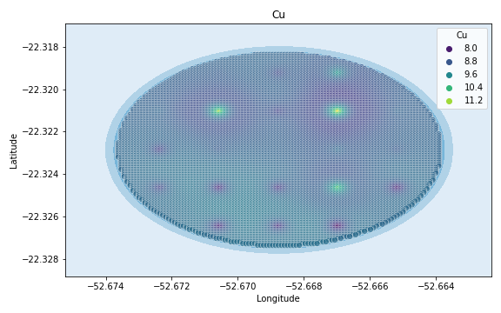
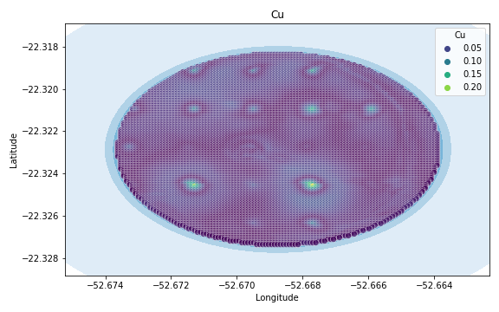
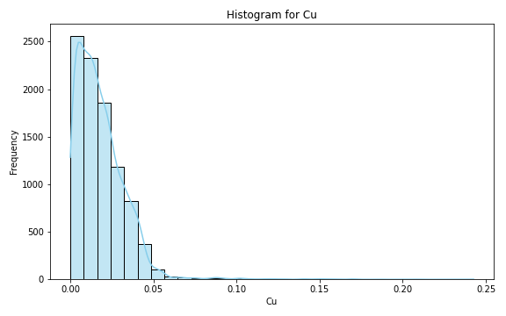
Analysis for column: Cu Model: Linear Regression
Statistics:
mean 1.827570e-02
std 1.522817e-02
min 1.333581e-07
25% 7.366896e-03
50% 1.537802e-02
75% 2.568985e-02
80% 2.885512e-02
85% 3.250890e-02
90% 3.673764e-02
95% 4.195121e-02
99% 6.338632e-02

Slide 9
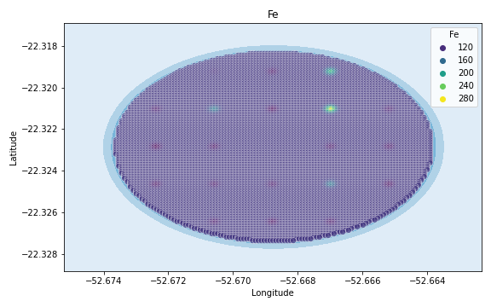
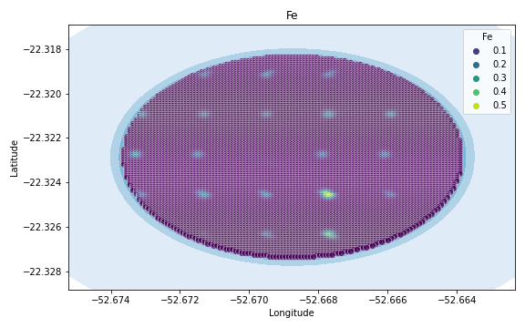
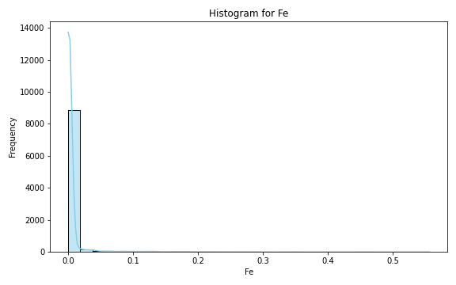
Analysis for column: Fe Model: Linear Regression
Statistics:
mean 5.905217e-03
std 2.770905e-02
min 4.260066e-08
25% 4.387457e-04
50% 1.026087e-03
75% 1.705264e-03
80% 1.913906e-03
85% 2.347032e-03
90% 3.767019e-03
95% 1.817595e-02
99% 1.413608e-01

Slide 10
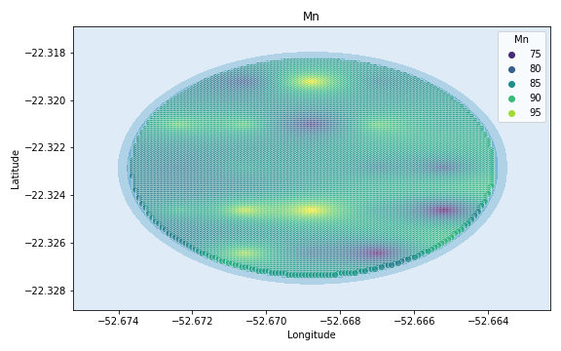
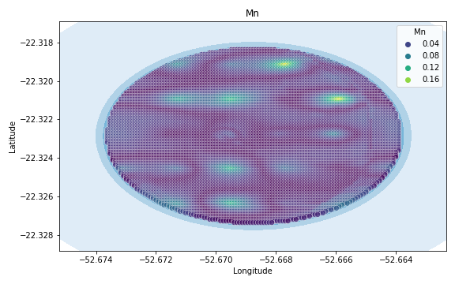
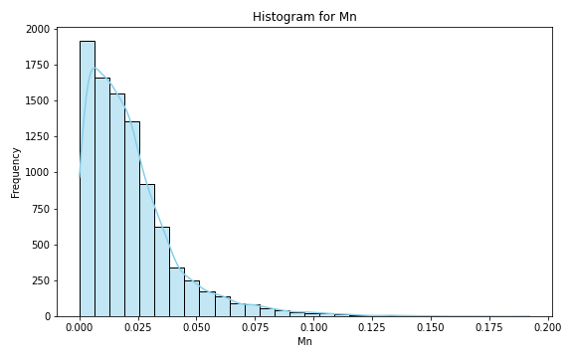
Analysis for column: Mn Model: Linear Regression
Statistics:
mean 0.022023
std 0.020360
min 0.000002
25% 0.007947
50% 0.017295
75% 0.029191
80% 0.032813
85% 0.037626
90% 0.046022
95% 0.061799
99% 0.099483

Slide 11
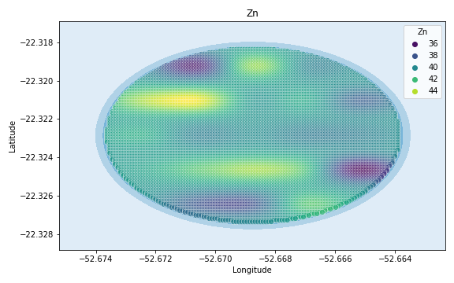
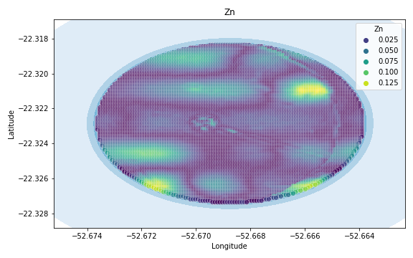
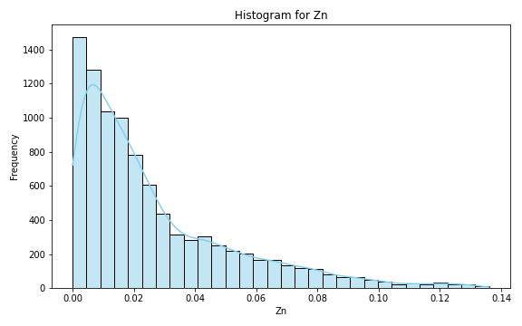
Analysis for column: Zn Model: Linear Regression
Statistics:
mean 2.641948e-02
std 2.597151e-02
min 8.429645e-07
25% 7.447595e-03
50% 1.751068e-02
75% 3.725459e-02
80% 4.452714e-02
85% 5.326735e-02
90% 6.531475e-02
95% 8.117284e-02
99% 1.162407e-01

Slide 12
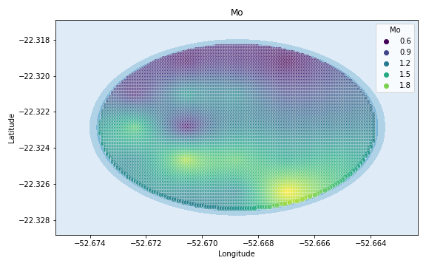
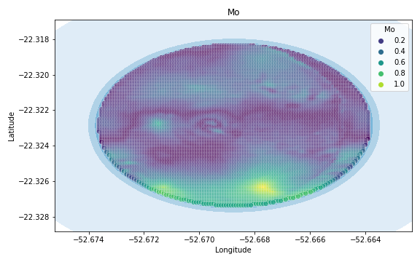
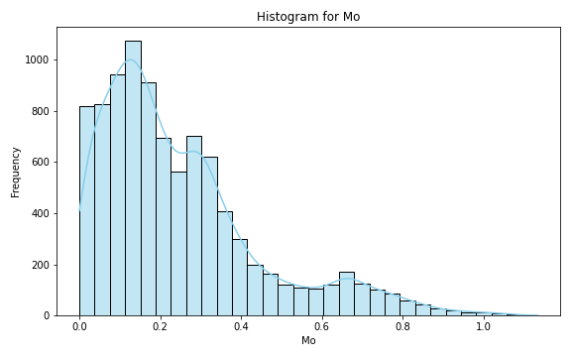
Analysis for column: Mo Model: Linear Regression
Statistics:
mean 0.248324
std 0.200432
min 0.000065
25% 0.104359
50% 0.193251
75% 0.330015
80% 0.370225
85% 0.430354
90% 0.551961
95% 0.688815
99% 0.861675

Slide 13
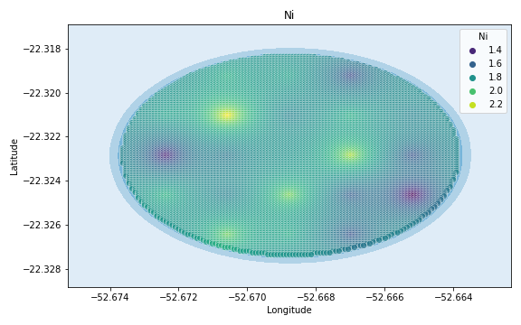
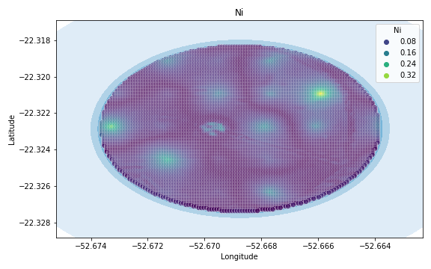
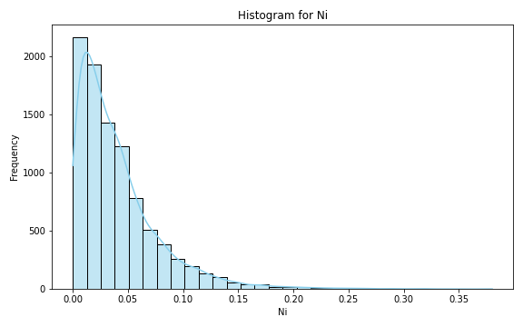
Analysis for column: Ni Model: Linear Regression
Statistics:
mean 0.040464
std 0.038067
min 0.000006
25% 0.013782
50% 0.030289
75% 0.054533
80% 0.062379
85% 0.073422
90% 0.087952
95% 0.114012
99% 0.181029

Slide 14
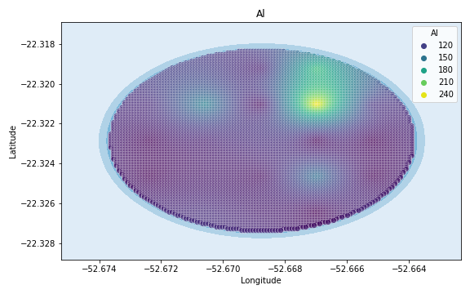
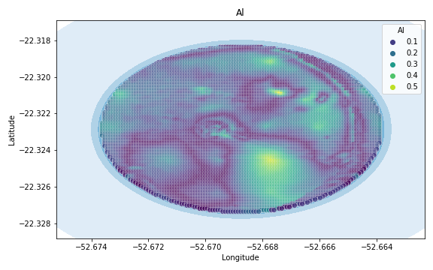
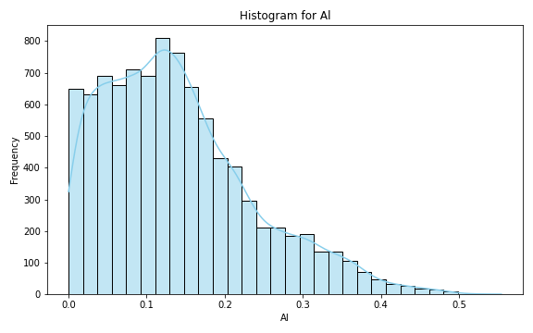
Analysis for column: Al Model: Linear Regression
Statistics:
mean 0.139922
std 0.096157
min 0.000030
25% 0.065773
50% 0.124916
75% 0.193286
80% 0.213160
85% 0.239692
90% 0.280482
95% 0.331527
99% 0.412313

Slide 15
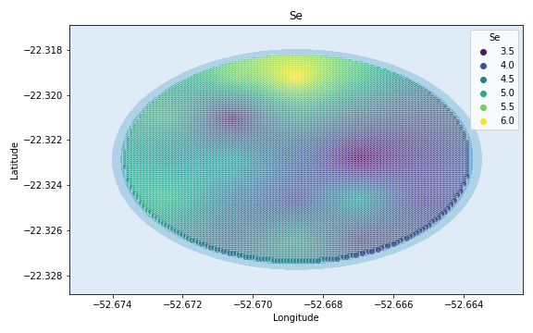
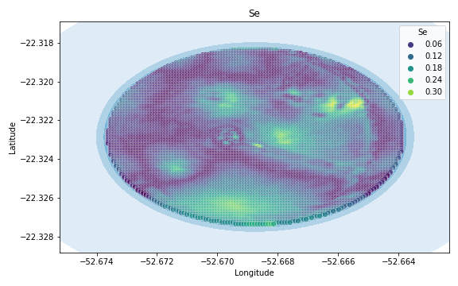
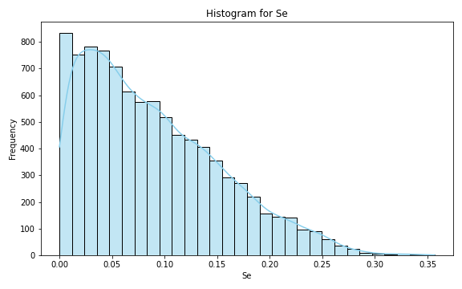
Analysis for column: Se Model: Linear Regression
Statistics:
mean 8.853879e-02
std 6.532913e-02
min 6.913584e-07
25% 3.522029e-02
50% 7.562418e-02
75% 1.309294e-01
80% 1.448236e-01
85% 1.611744e-01
90% 1.825472e-01
95% 2.157381e-01
99% 2.622910e-01

Slide 16
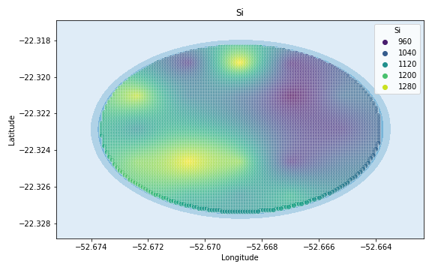
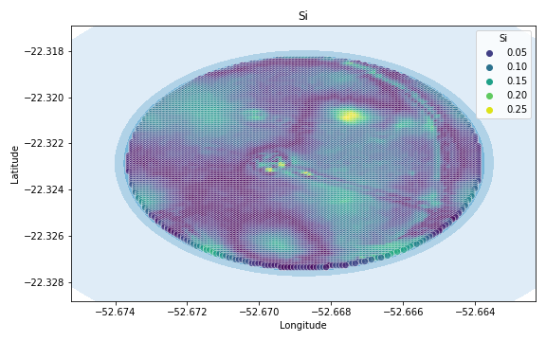
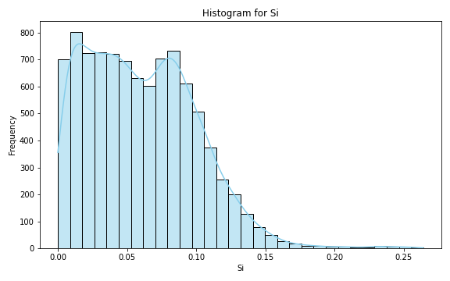
Analysis for column: Si Model: Linear Regression
Statistics:
mean 0.060585
std 0.039636
min 0.000012
25% 0.027694
50% 0.056942
75% 0.087730
80% 0.094191
85% 0.102226
90% 0.111606
95% 0.127067
99% 0.162359

Slide 17
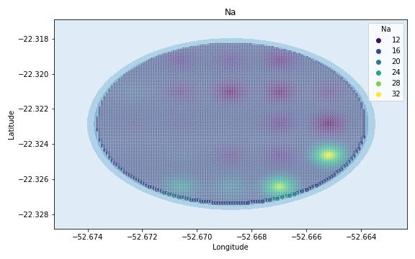
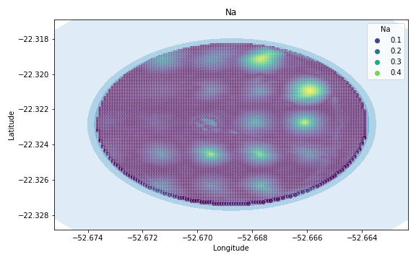

Analysis for column: Na Model: Linear Regression
Statistics:
mean 0.051156
std 0.071903
min 0.000002
25% 0.008077
50% 0.022907
75% 0.062989
80% 0.079462
85% 0.101545
90% 0.135056
95% 0.202616
99% 0.361640

Slide 18



Analysis for column: Va Model: Linear Regression
Statistics:
mean 0.168822
std 0.148047
min 0.000042
25% 0.069588
50% 0.137640
75% 0.203549
80% 0.230803
85% 0.279070
90% 0.349128
95% 0.492718
99% 0.740579

Slide 19



Analysis for column: DRIS_N Model: Linear Regression
Statistics:
mean 0.769857
std 15.017385
min 0.000035
25% 0.116494
50% 0.233540
75% 0.412437
80% 0.473601
85% 0.561851
90% 0.712542
95% 1.173032
99% 4.701470

Slide 20



Analysis for column: DRIS_P Model: Linear Regression
Statistics:
mean 0.050299
std 0.057928
min 0.000002
25% 0.020960
50% 0.042924
75% 0.069755
80% 0.076411
85% 0.083375
90% 0.090897
95% 0.108082
99% 0.185160

Slide 21



Analysis for column: DRIS_K Model: Linear Regression
Statistics:
mean 10.680600
std 433.888989
min 0.000775
25% 0.307296
50% 0.582891
75% 1.572229
80% 2.468933
85% 4.444109
90% 7.732155
95% 15.394302
99% 74.752201

Slide 22



Analysis for column: DRIS_Ca Model: Linear Regression
Statistics:
mean 0.189877
std 0.171620
min 0.000007
25% 0.075654
50% 0.151242
75% 0.232839
80% 0.273441
85% 0.341040
90% 0.424771
95% 0.528417
99% 0.787283

Slide 23



Analysis for column: DRIS_Mg Model: Linear Regression
Statistics:
mean 0.410899
std 3.539845
min 0.000008
25% 0.093718
50% 0.173938
75% 0.324979
80% 0.388038
85% 0.477357
90% 0.631470
95% 0.984655
99% 3.089807

Slide 24



Analysis for column: DRIS_S Model: Linear Regression
Statistics:
mean 0.098865
std 0.792657
min 0.000010
25% 0.028238
50% 0.063847
75% 0.106160
80% 0.119942
85% 0.157039
90% 0.207147
95% 0.287147
99% 0.458229

Slide 25



Analysis for column: DRIS_B Model: Linear Regression
Statistics:
mean 1.414716e-01
std 2.181330e-01
min 2.236255e-07
25% 4.905033e-02
50% 9.271413e-02
75% 1.602299e-01
80% 1.860685e-01
85% 2.212659e-01
90% 2.823584e-01
95% 4.148703e-01
99% 9.266935e-01

Slide 26



Analysis for column: DRIS_Cu Model: Linear Regression
Statistics:
mean 0.172553
std 0.296124
min 0.000078
25% 0.052470
50% 0.112037
75% 0.169826
80% 0.182660
85% 0.202887
90% 0.252083
95% 0.555408
99% 1.695675

Slide 27



Analysis for column: DRIS_Fe Model: Linear Regression
Statistics:
mean 0.306833
std 1.405918
min 0.000063
25% 0.059556
50% 0.131881
75% 0.210520
80% 0.251489
85% 0.377708
90% 0.589413
95% 0.977985
99% 3.599651

Slide 28



Analysis for column: DRIS_Mn Model: Linear Regression
Statistics:
mean 1.651907e-03
std 6.296815e-02
min 8.127317e-08
25% 1.132055e-04
50% 2.389571e-04
75% 4.279274e-04
80% 4.964535e-04
85% 5.800159e-04
90% 7.136495e-04
95% 1.051997e-03
99% 4.666170e-03

Slide 29



Analysis for column: DRIS_Zn Model: Linear Regression
Statistics:
mean 1.355567
std 14.536206
min 0.000004
25% 0.166884
50% 0.310521
75% 0.457073
80% 0.527898
85% 0.808429
90% 1.416046
95% 2.835429
99% 16.596362

Slide 30



Analysis for column: IMS Model: Linear Regression
Statistics:
mean 1.157006e-02
std 3.055562e-01
min 6.048765e-07
25% 4.965165e-04
50% 1.028905e-03
75% 1.888430e-03
80% 2.187101e-03
85% 2.592611e-03
90% 3.220018e-03
95% 5.264440e-03
99% 9.435608e-02

Slide 31



Analysis for column: IBN Model: Linear Regression
Statistics:
mean 0.063642
std 0.144166
min 0.000033
25% 0.022444
50% 0.038469
75% 0.066103
80% 0.075932
85% 0.089416
90% 0.112176
95% 0.159550
99% 0.488114

